Slide 1
Java Programming

Slide 2
Topics to Cover
Java “Hello World”
Git/VCS
Variables and Types
Basic Operations
+ - * /
Functions
While Loops
For Loops
Collections

Slide 3
Topics to Cover (cont.)
Classes
Inheritance

Slide 4
Assignments and Grading (tentative)
Assignments will be given based on pace of class
Homework
1-2 assignments per week based on content covered that week
Exams (Very few, if any)
Programming is cumulative
Homework will provide a good running gauge of progress

Slide 5
Class Homepage
https://github.com/HCA-Java-2015

Slide 6
Hello World Example

Slide 7
Version Control Systems (VCS)
Maintain history
Histories are stored in repositories
Each “event”(commit) in the history contains:
Who made the change
What was changed
When the change was made
Why the change was made

Slide 8
Git: a Distributed VCS
Each workspace maintains it own history
Commits are made to the local workspace’s history
Commits are then “pushed” and “pulled” between workspaces

Slide 9
Github
“Central” repository where git repositories are hosted
Not the only git hosting platform, just a very popular one

Slide 10
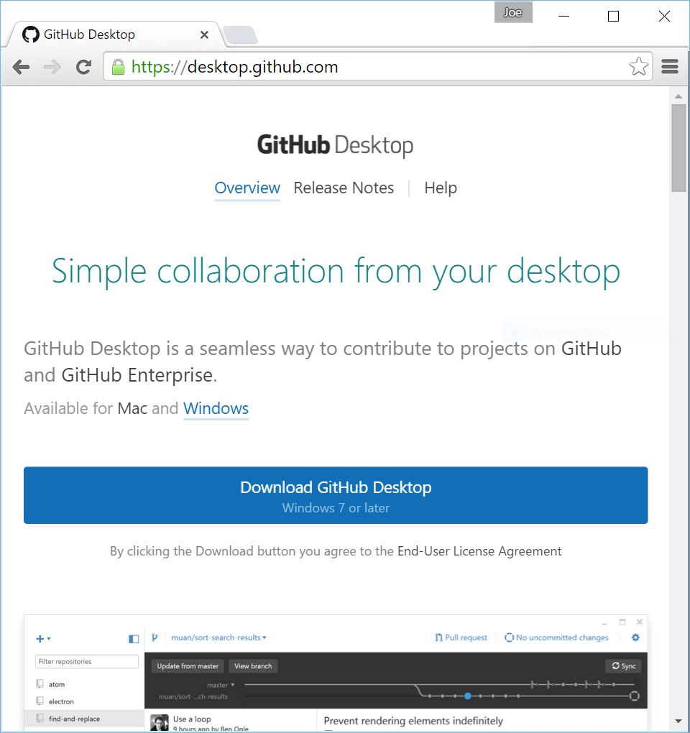
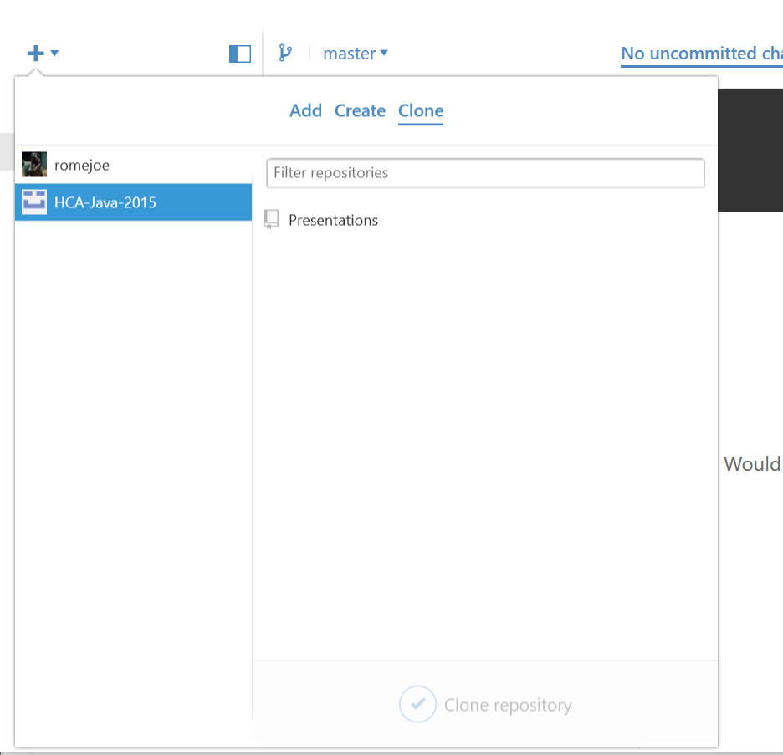
Retrieving the presentation repository

